Slide 1
Containers on Azure
Abdul Rasheed Feroz Khan
Microsoft MVP – Azure.

Slide 2
Agenda:
Containers
Docker and its architecture
Running a Container
Why Docker on Azure?
Azure Container Services
Customer Stories
Hands on Lab

Slide 3
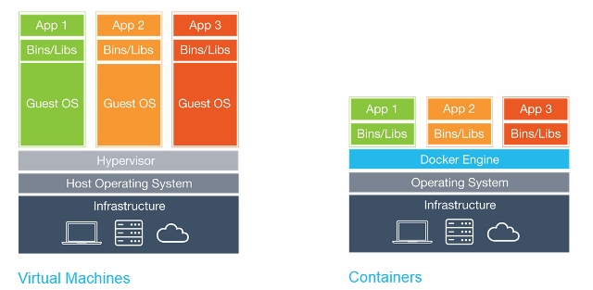
Containers
Light weight alternatives to Virtual Machines
Smaller, less expensive, faster to start up, and self-contained

Slide 4
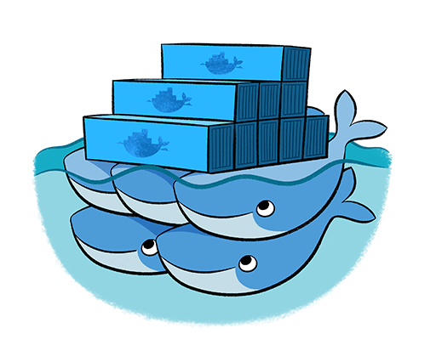
Dockers
Leading Open-Source containerization platform
“Docker containers wrap up a piece of software in a complete filesystem that contains everything it needs to run: code, runtime, system tools, system libraries – anything you can install on a server. This guarantees that it will always run the same, regardless of the environment it is running in”
Support Natively in Azure
https://docs.docker.com/docker-for-azure/

Slide 5
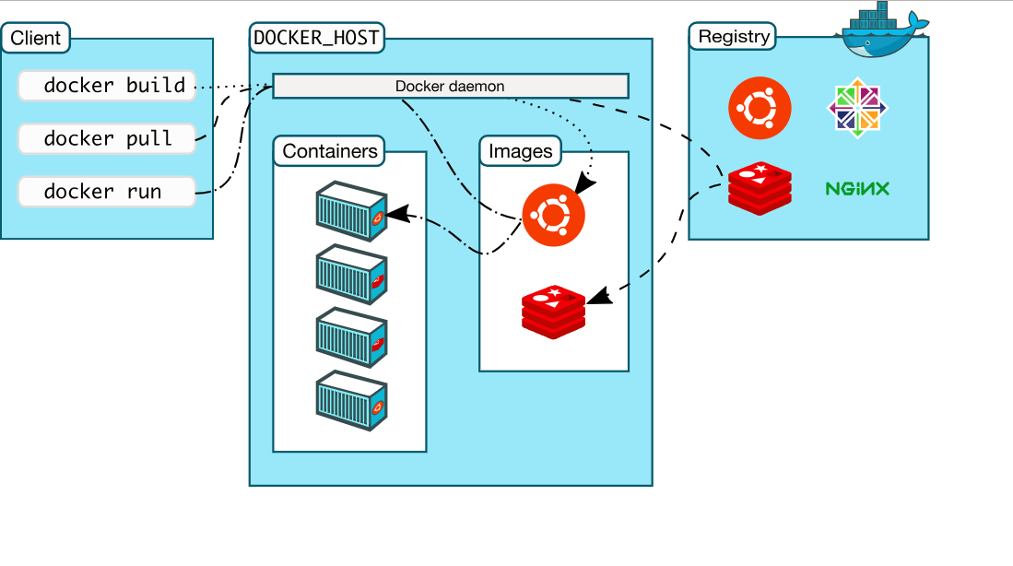
Docker Architecture
Notes:
recurrence - time-based trigger with an interval
polling - pull a certain endpoint at a given time interval, monitor a website for changes to data on their system
event-based - events that occur in Azure, such as a message being written to the Service Bus queue
webhook - expose Logic Apps as a webhook and allow them to be called by HTTP endpoints

Slide 6
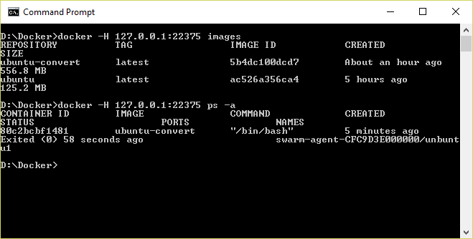
Docker CLI
Command-line interface for Docker, available for Linux, OS X, and Windows (available separately or as part of Docker Toolbox)

Slide 7
Running a Container
docker run -i -t ubuntu /bin/bash
docker - Docker CLI Command
run -i –t - Run Container with interactive terminal
ubuntu - Pull Ubuntu image from Docker hub or local registry
/bin/bash - Command to execute in the container

Slide 8
Common Docker CLI Commands
docker run - Use an image to run a container
docker pull - Pull an image from a registry
docker build - Build a Docker image
docker images - List available Docker images
docker ps - List running Docker containers
docker exec - Execute a command in a container
docker stop - Stop a running container

Slide 9
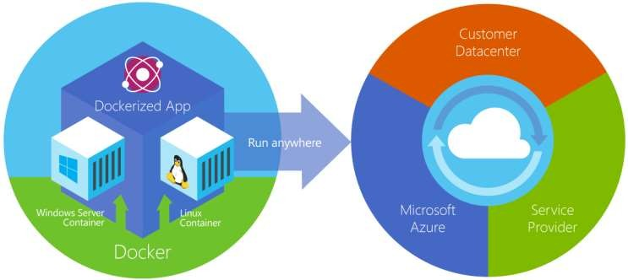
Azure Container Service
Provides robust, ready-to-use Docker hosting environment
Uses open-source orchestration tools (DC/OS and Swarm)

Slide 10
Container Orchestration
Facilitates deployment and management of containers
Containers by design are intended to be deployed in large volumes with some applications using dozens to even thousands of containers
With this type of scale, automating container deployment and management with orchestration software becomes necessary
Azure Container service supports Kubernetes, DC/OS, and Docker Swarm

Slide 11
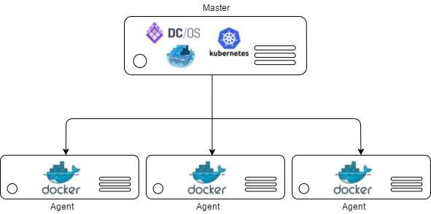
Container Clusters
Facilitate load balancing, scalability, and high availability
A cluster is composed of master nodes which control the orchestration, and agent nodes that host the containers

Slide 12

Kubernetes
Open-source orchestration engine from Google
Provides a robust framework for container orchestration, yet remains lightweight and scalable
Supported by Azure Container Service and tightly integrated with ACS, allowing Kubernetes to modify deployments

Slide 13
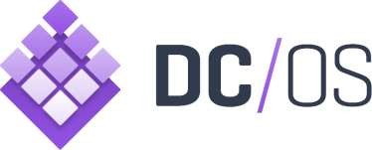
DC/OS
Datacenter Operating System built on Apache Mesos
Creates logical data centers and abstracts underlying hardware
Provides resources traditionally provided by infrastructure, including networking, DNS, and load balancing
Natively supported by Azure Container Service

Slide 14
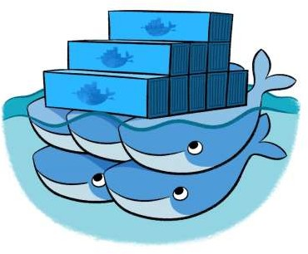
Docker Swarm
Docker’s own orchestration engine
Current releases of the Docker engine have “Swarm Mode” built in and can many of the same things that other orchestration engines do
Lacks a GUI, but makes up for it with tight integration with Docker
Natively supported by Azure Container Service

Slide 15
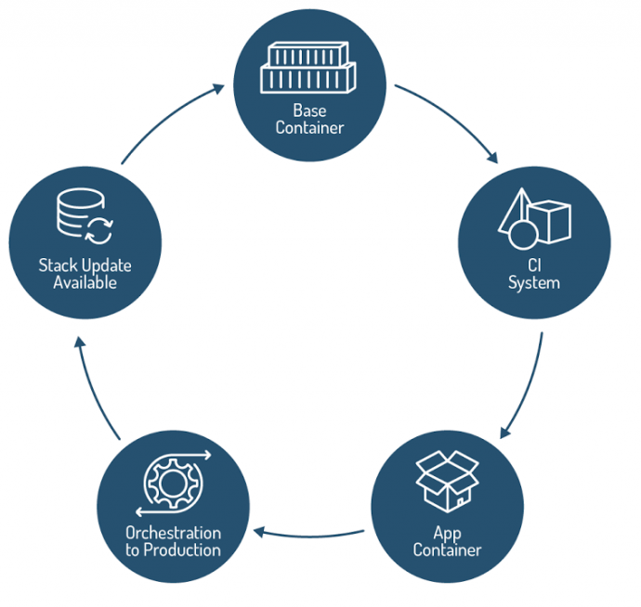
Lifecycle management of Containerized Applications
Source: The New Stack

Slide 16
Customer Stories
Notes:
Middle one – design ideas

Slide 17

“Red Hat really impressed us with its enterprise grade support. We were surprised that Red Hat open source and Azure support resided in the same office”
Richard Hum: Studio Head
Throwback Entertainment

Slide 18
Customer profile
Canadian-based Throwback Entertainment develops, creates and publishes immersive and interactive gaming titles. Its portfolio of games has accumulated over US$3.5 billion in revenue, sold over 200 million copies and distributed to over 35 countries worldwide. Notable games include Vexx, Extreme G Racing, Gladiator: Sword of Vengeance, Deflector, Aggressive Inline, SX Superstar and more

Slide 19
Business goal
When Throwback acquired Acclaim Entertainment it gained an entire gaming library. Alongside selling these games it has also been redeveloping some of them. It wanted to rework a previous classic, released in 1999, called Iggy’s Reckin Balls by bringing it up to date and enabling groups of players to play against each other.

Slide 20
Tactics
It decided to use the Red Hat open source software to redevelop the game and also chose to host it from the Azure platform because of its flexibility, always-on availability and close support for Red Hat. Importantly it also chose Red Hat on Azure to host Docker containers managed by Kubernetes, which was considered important to develop a cutting-edge back-end for cloud gaming

Slide 21
Results
Throwback has been able to launch the game successfully from Azure with a raft of new features such as 8-player groups and HD graphics. As such it has created a high-profit game that has been radically modernized while retaining its original features. Supported by Azure, the game has been successfully launched as a game for all age groups and one that is characterised from the back-end by security, stability and scalability.

Slide 22
Software and Services
Microsoft Azure
Open Source Technologies
Red Hat Linux
Docker
Kubernetes

Slide 23
Demo

